Slide 1
Far Western University CSE Community:
Computer Engineering
Let’s Begin our journey...

Slide 2
Contents we discuss about
There are several topics in CSE, we discuss about below some of it’s summary is provided..
Problems | Problems which we faced while joining the Engineering..
Our Aims | Aim of opening this community.
Events/Seminars | This could be helpful for you guys for involvement in extra curriculum activities.
Rules/Regulations | All of the members should be cooperative and helpful
Resources | We can conduct our all events physically in our seminar room if not possible also we conduct webinar for those events.
Responsibilities | To ensure effective communication of club activities with students.
For more info: CSE Club FWU
You can visit our : Discord server

Slide 3
Whoa!
This can be the part of the presentation where you introduce ourself…

Slide 4
Table of contents
Overview
Experts
01
03
Aim
Duty
02
04
To contribute to peer mentoring and other relevant engagement initiatives.
Establish Our CSE Community
To prepare club members for national and international competitions
We organize events, seminars, conferences and study webinars which offer students and alumni a meaningful educational experience.

Slide 5
Major Duties
01
Our duties/Responsibilities for establish this Community

Slide 6
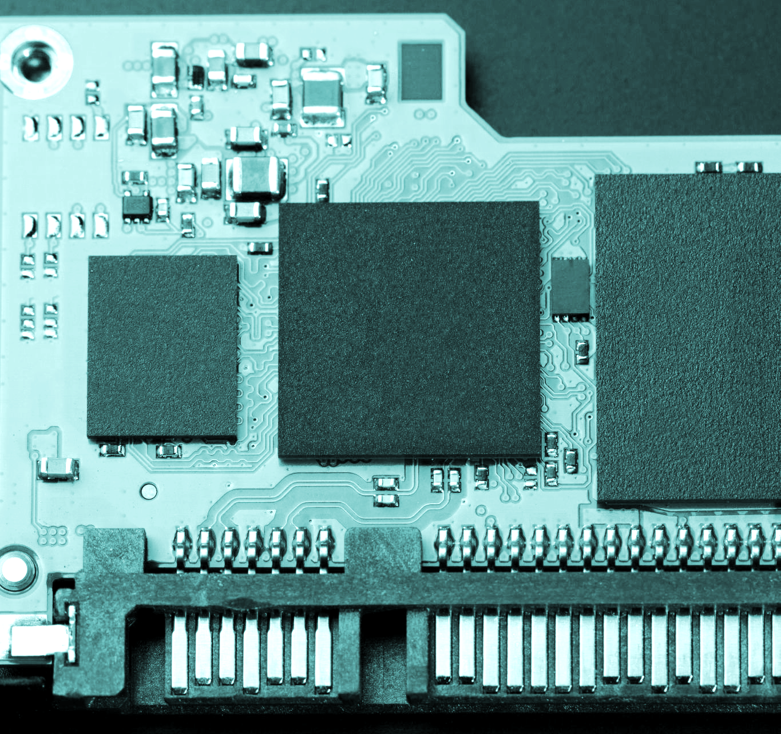
About Duties Of Our Community
Some major duties of Our Club:
To ensure effective communication of club activities with students
To organize live programming competitions.
To hold latest trends and technology seminars
To provide leadership and direction to other club members.
And the most important thing:To organize on campus weekly meeting to ensure projects are active and students are involved also to share the outcomes, problems, and approaches.

Slide 7
How are we different?
Them
Us
Never conduct any Seminars Coding Competitions, Trainings
Our main aim is to provide the guidance to our juniors community members organizing Events Related to CSE

Slide 8
How we could organize Events…
Initially
Firstly, we organize events on WEB tech, programming in C/C++.we assure to provide necessary materials roadmap for learning any Skills
After that
We conduct the coding Competitions certificates, While they complete any of the Skills Completely.

Slide 9
Possible Works
Programming
Cybersecurity
App development
WEB Dev
Our main focus is enhancing the programming concepts of Students
We’ll Work on Linux OS penetration Testing Trainings.
We mentor you to work on App development through Java or JS,Angular.
We host the training Program Boot camps on Web Development

Slide 10

Fields for a CSE Students
Software Developer
Information Security Analyst
UX Designer
Mobile App Developer
Analyze users needs and then design and develop software to meet those needs.
install software, such as firewalls, to protect computer networks and systems.
Main role is to make a product or service usable, enjoyable, and accessible.
uses programming languages and development skills to create, test, and develop applications on mobile devices

Slide 11
Need Of Club
02
Why it is necessary for us to have a IT Club?
To provide computer and computerized device knowledge and mentored trainings.
To make the student able converts theoretical knowledge in practical work.
To enhance the professional development of our students, and networking among technical professionals

Slide 12

A picture is worth a thousand words

Slide 13
—Benjamin Franklin
“Tell me and I forget, teach me and I may remember, involve me and I learn.”

Slide 14

Objectives
To provide students a platform where they gain knowledge about the Anatomy of the Computer.
To provide students a platform where they can share their knowledge on current trends in Information Technology.
To make students aware of the evolving technologies by organizing Seminars, Workshops & Guest Lecturers.
To help students in enhancing their presentation and organizational skills.

Slide 15

Major Events
Git and Github Workshop
It was aimed for first year students who were new to programming and working remotely for the first time. The participants were made familiar with basic git commands which would be helpful for them to collaborate on their projects in future. This was achieved with a live demo of Git and Github implementation in real projects.

Slide 16
Experts
03
All Enthusiast Students,Seniurs,Teachers,Guest

Slide 17
Jobs in engineering
37%
45%
80%
Full Stack Developers
App Developers
Security Experts
full stack developers are highly versatile jacks-of-all-trades in an industry that demands comprehensive programming knowledge
App developers write software programs for use across mobile operating systems, including Apple, Android, and Windows device.
Cyber security experts are specialists in charge of monitoring the organization's network to prevent unauthorized access.

Slide 18
Gap: students vs jobs
Students
10%
Jobs
75%
Every year thousands of Engineering Graduates were passed but lack of skills they can't get jobs.
In market, There is huge demand of Well Qualified and skilled Engineer.

Slide 19

Career opportunities in Global
Civil Engineering
Computer Engineering
Architecture Engineering
In context of our country there is huge demand of Civil Engineers.
While we talk Globally, There's huge demand for well skilled Computer Engineer
A person in this role designs the mechanical and structural systems of a building, as well as managing challenges that arise with its electrical and lighting systems.
This chart shows the importance of Computer Engineering in Global Market.

Slide 20
Frequent questions
How will the Events be Organized?
How many students will there be?
Is there any Compitisions?
Mainly Physically in labs also through Online if required.
Any number of students may join us.
Yes, After any events we conduct challenges and compititions.

Slide 21
Events Based On Semesters
semesters
Semester1
Semester2
Semester3
Complete Overview For Open Source Git And Github
Operating systems Mainly focused On Linux
Web Development
C++ Basics
Web/App Development Trainings
Data Structures Classes.
Circuit Simulation Basics.
Git and github basics
C Programming
Compiler Installation for C

Slide 22
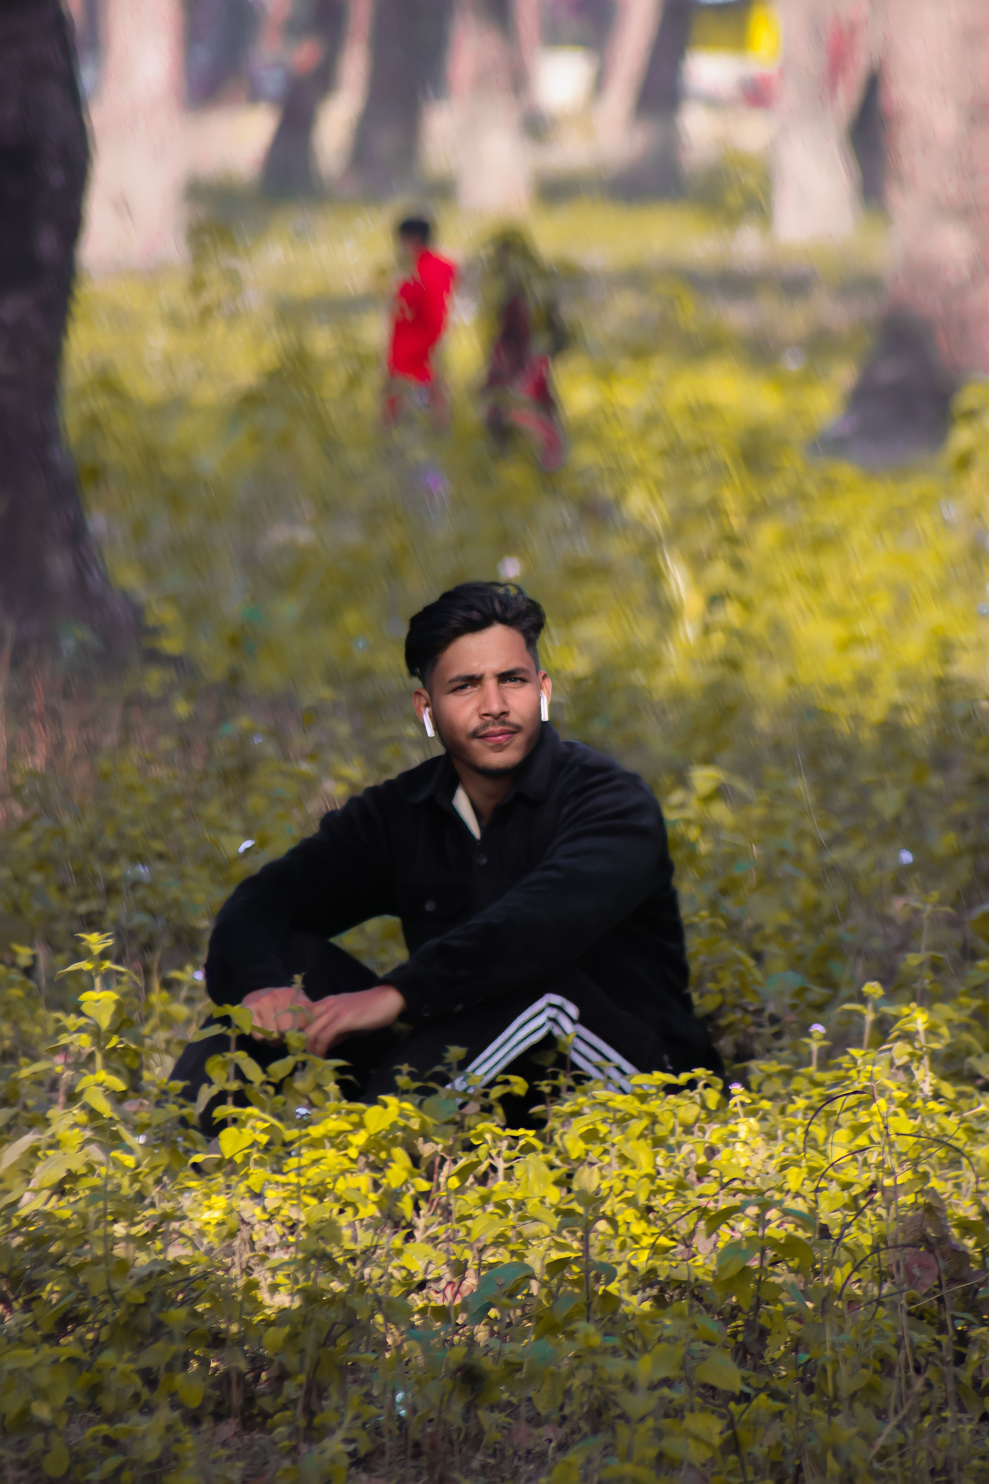
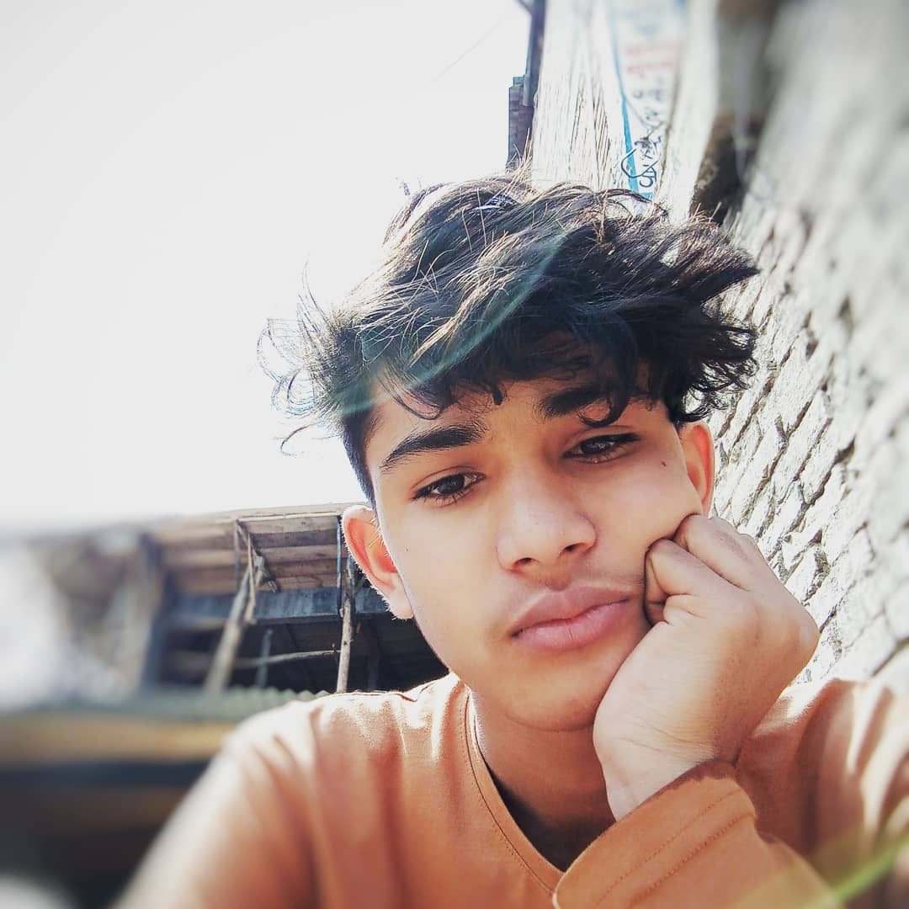
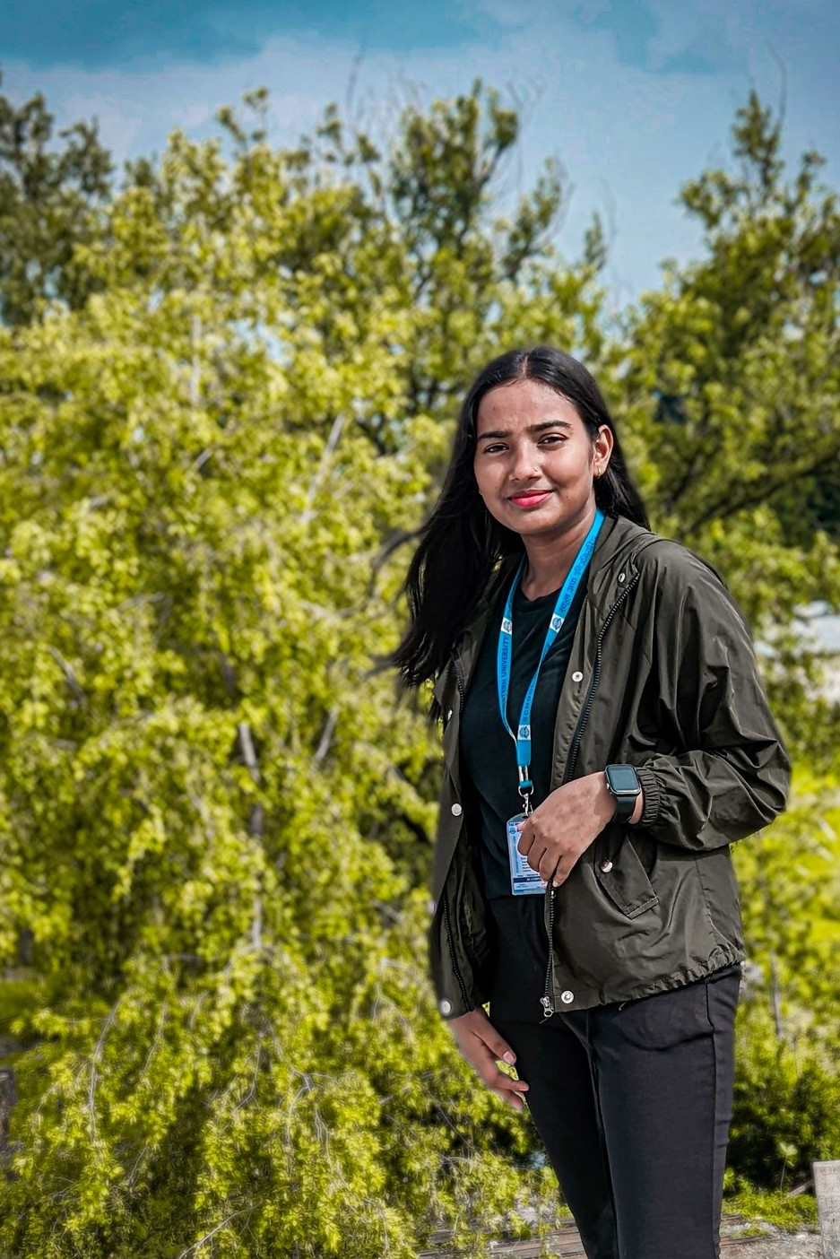
Our Leaders
Pradip Bhatt
Dipak Raj Giri
Babita Bhatt
You can call me through My social handles or at pradipbhatt.com.np
You can contact me on
giridipak@gmail.com
You can contact me on bhattbabita123@gmail.com

Slide 23
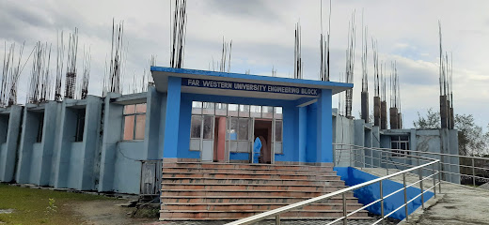
Computer Engineering School Of Engineering
Our main aim is to make our self able to compit any of IT fests,Hackthons,Coding Competitions.

Slide 24
Thanks!
Do you have any questions?
bhattsammar04@gmail.com
+9779810652734
Pradipbhatt.com.np

